Slide 1
Recurrent Neural Networks
Trong-Hop Do
Lecture 5 -
1

Slide 2
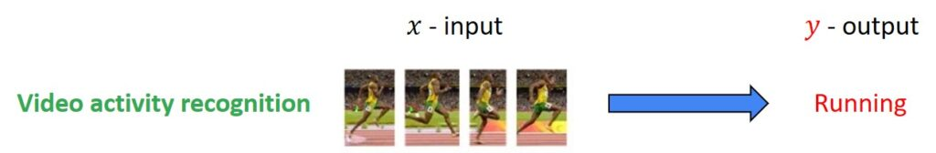
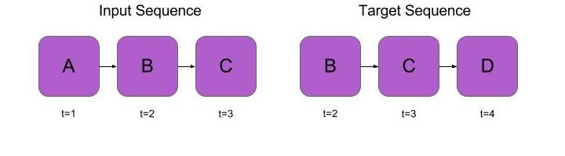
Sequence model

Slide 3
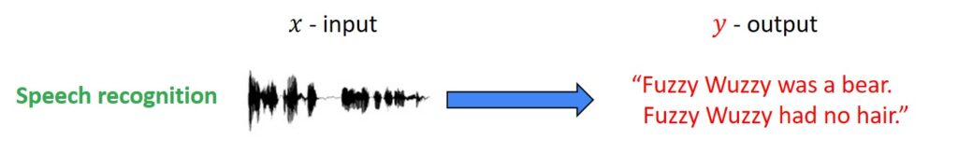
Real-Life Examples of RNN

Slide 4
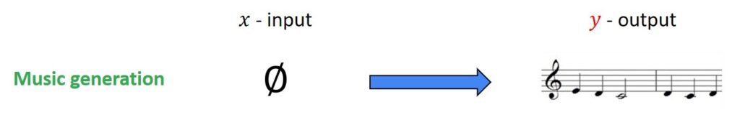
Real-Life Examples of RNN

Slide 5
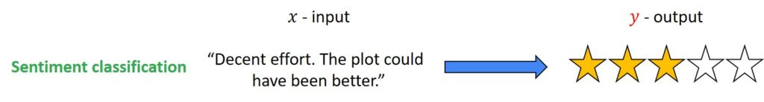
Real-Life Examples of RNN

Slide 6
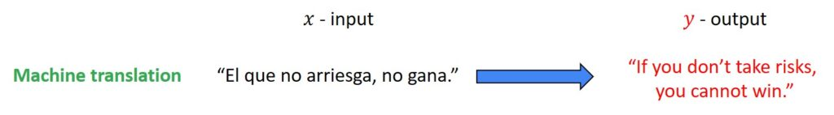
Real-Life Examples of RNN

Slide 7
Real-Life Examples of RNN

Slide 8
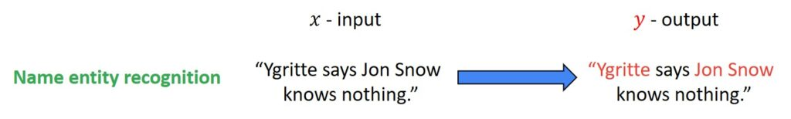
Real-Life Examples of RNN

Slide 9
Different Scenarios for Use of RNN
Input x and Output y are both sequences
Input x and Output y have same lengths
Input x and Output y have different lengths
Only Input x is a sequence
Only Output y is a sequence

Slide 10
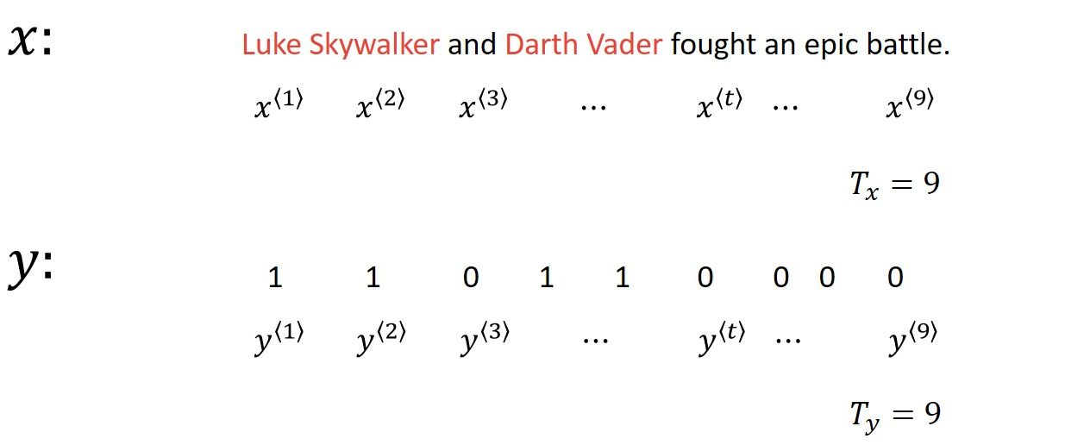
Notation Used For Sequence Models

Slide 11
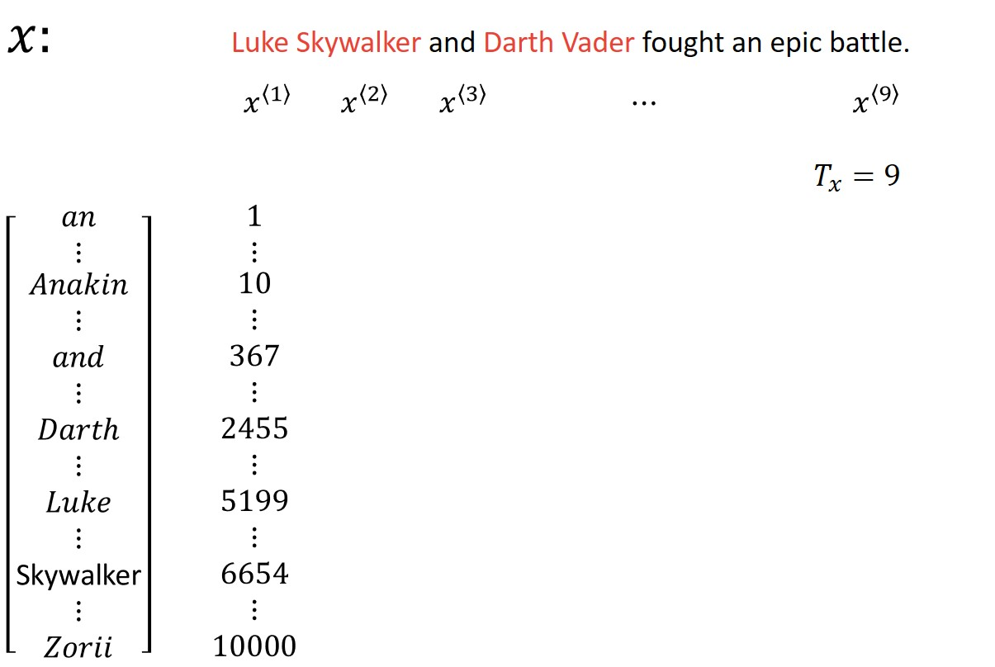
Representation of Words in Natural Language Processing

Slide 12
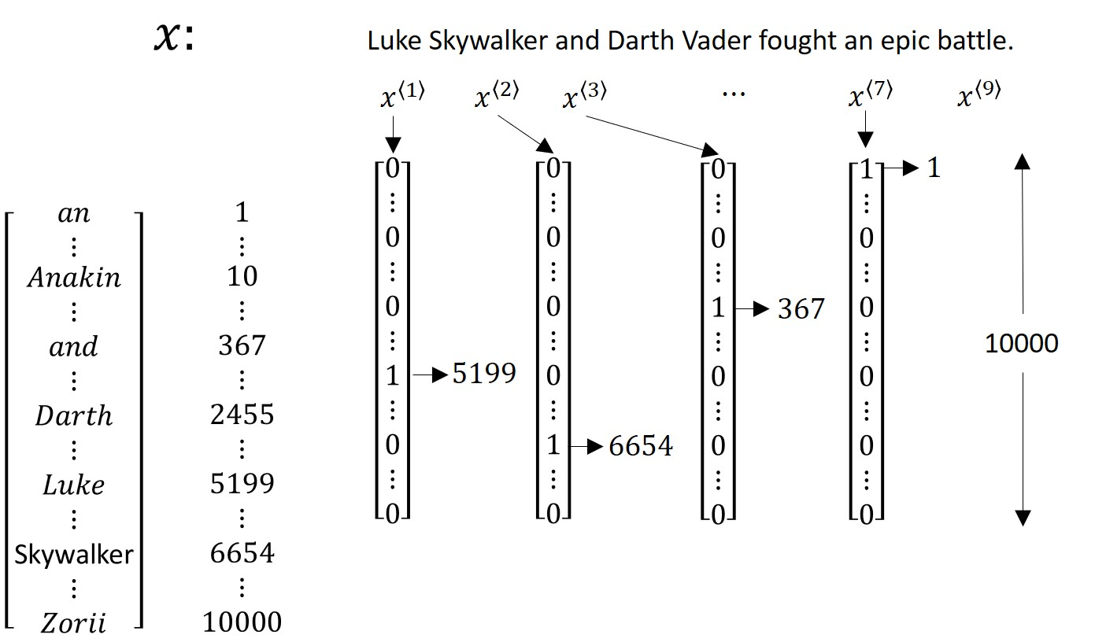
Representation of Words in Natural Language Processing

Slide 13
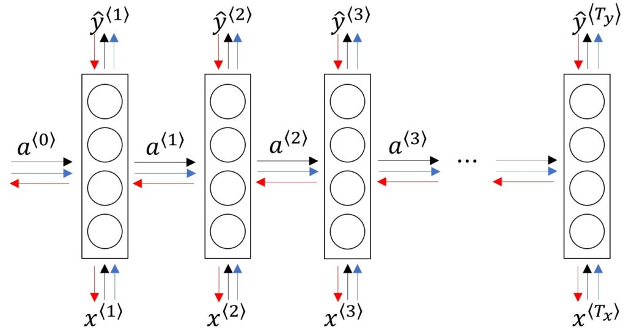

Slide 14
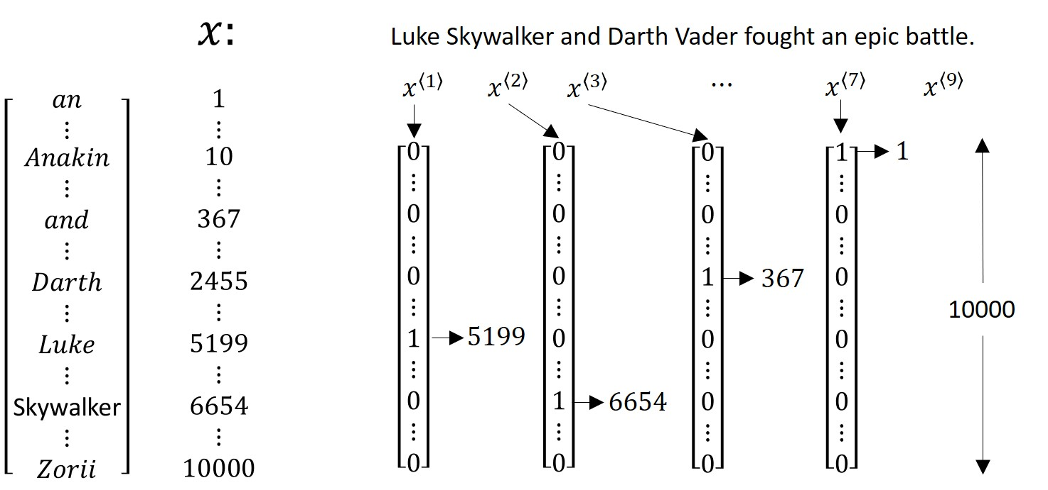
Mapping Input and Output

Slide 15
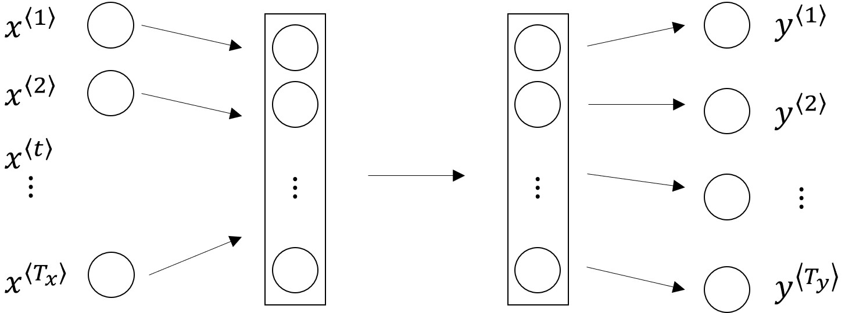
Drawbacks of Using Standard Neural Networks
Length of input and output might be different
Feature sharing is difficult

Slide 16
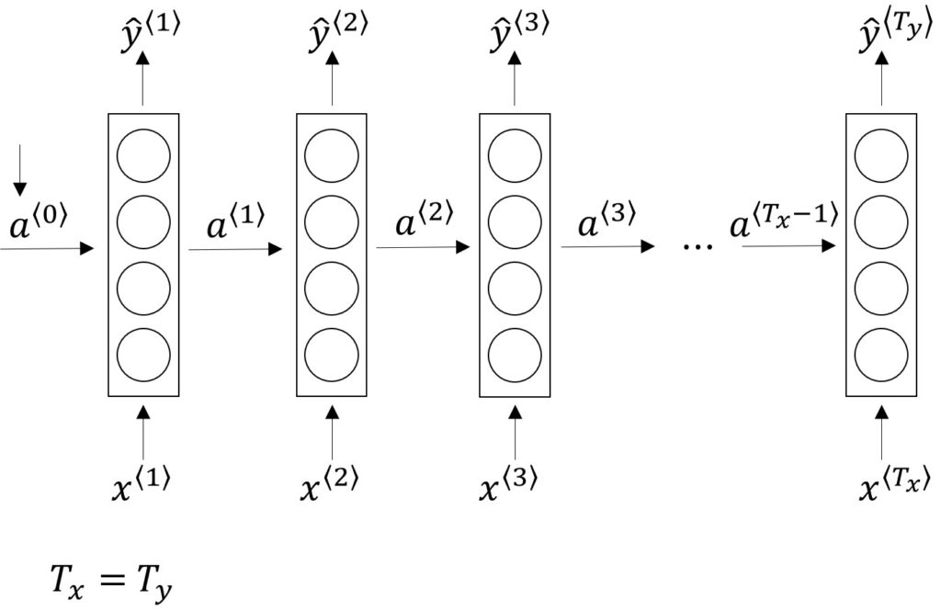
The architecture of a Recurrent Neural Network

Slide 17
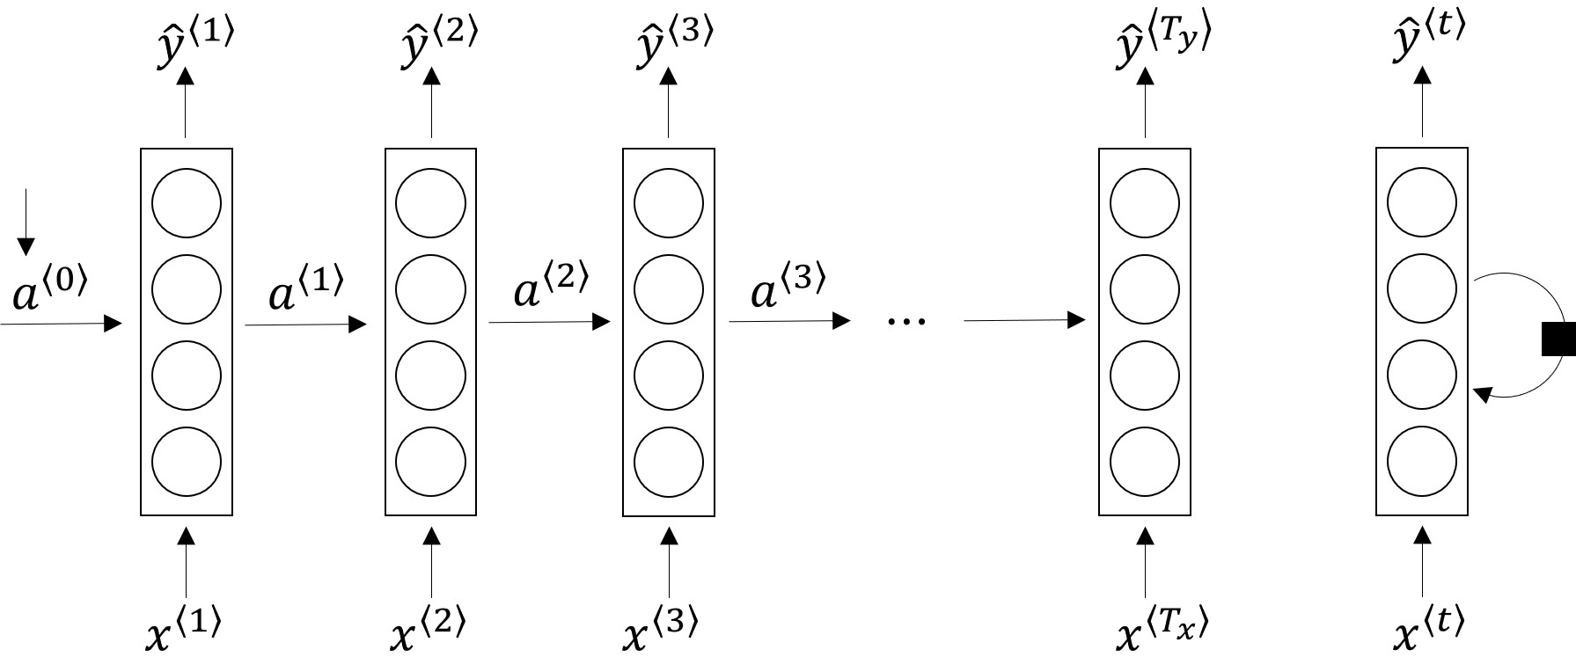
Another way of representing RNN

Slide 18
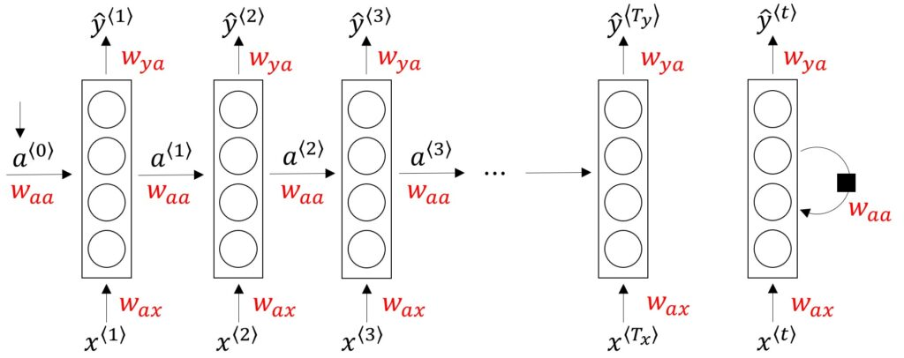
Sharing parameters in RNN

Slide 19
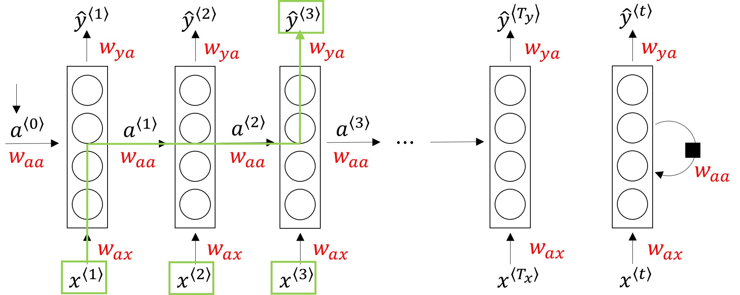
Passing information from previous inputs

Slide 20
Unidirectional Recurrent Neural Networks
He said, “Teddy Roosevelt was a great President.”
He said, “Teddy bears are on sale!”

Slide 21
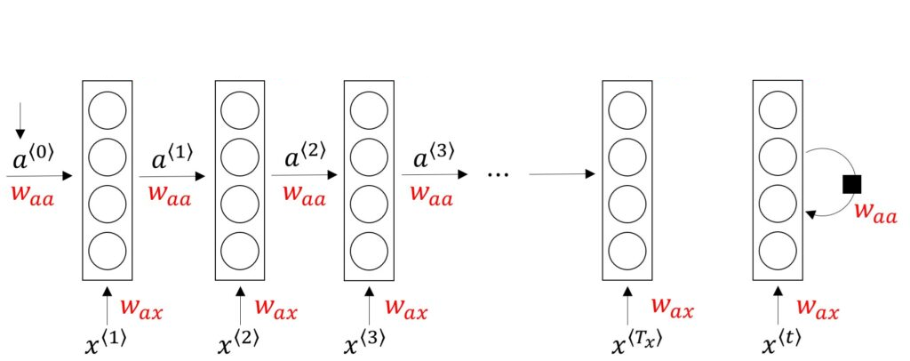
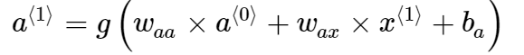
Forward propagation

Slide 22
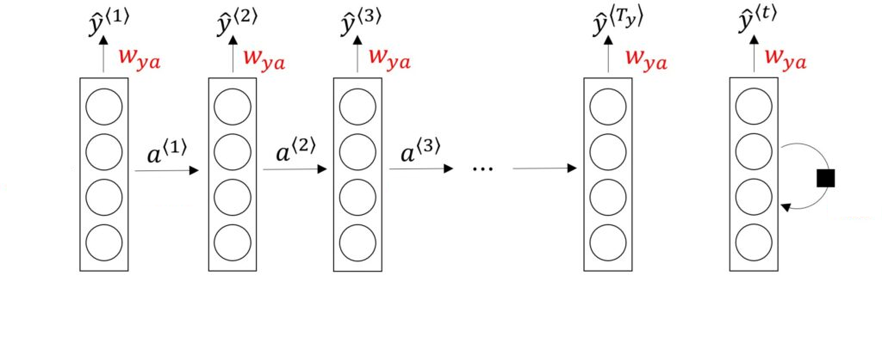
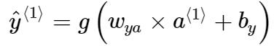
Forward propagation

Slide 23
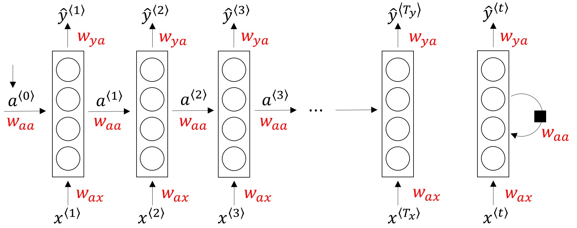
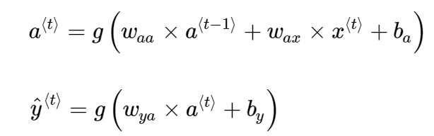
Forward propagation

Slide 24
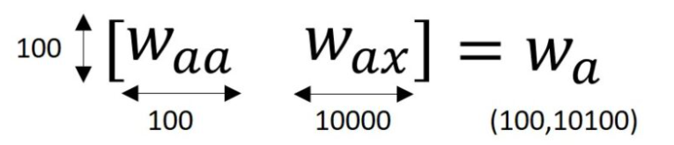
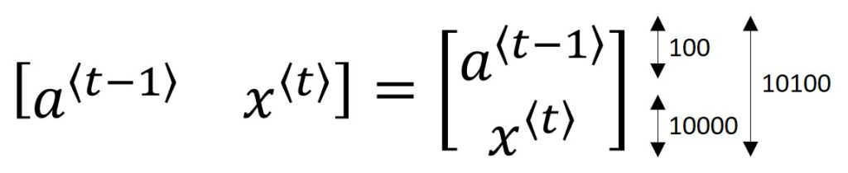
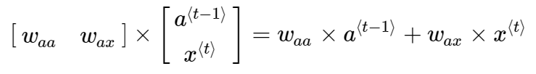
Forward propagation

Slide 25
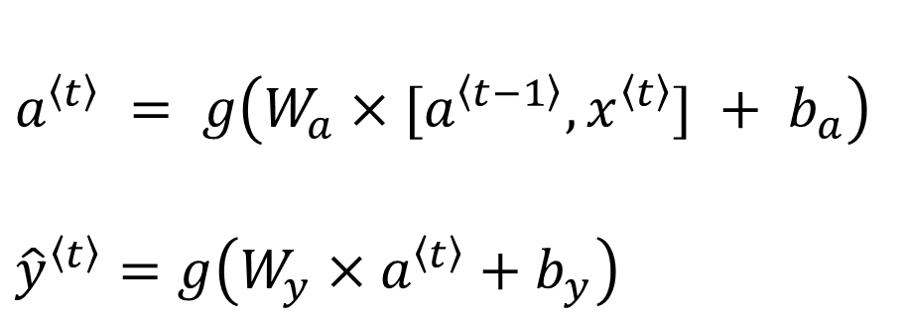
Forward propagation
$a^{\left\langle t\right\rangle } = g\left(W_{a}×[a^{\left\langle t−1\right\rangle },x^{\left\langle t\right\rangle }] + b_{a}\right)$
${\hat{y}}^{\left\langle t\right\rangle }=g\left(W_{y}×a^{\left\langle t\right\rangle }+b_{y}\right)$

Slide 26
Back Propagation in RNN

Slide 27
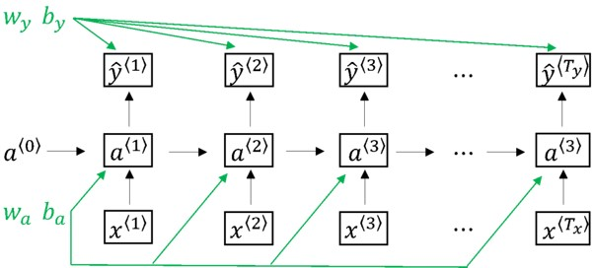
Back Propagation in RNN

Slide 28
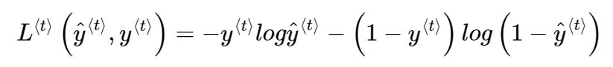
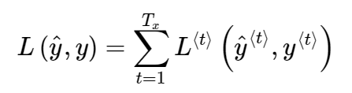
Back Propagation in RNN

Slide 29
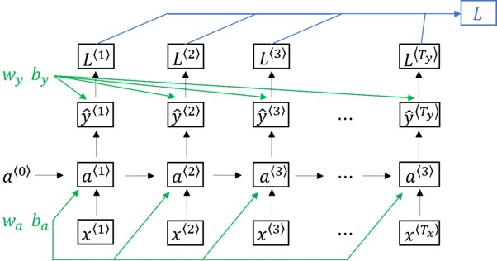
Back Propagation in RNN

Slide 30
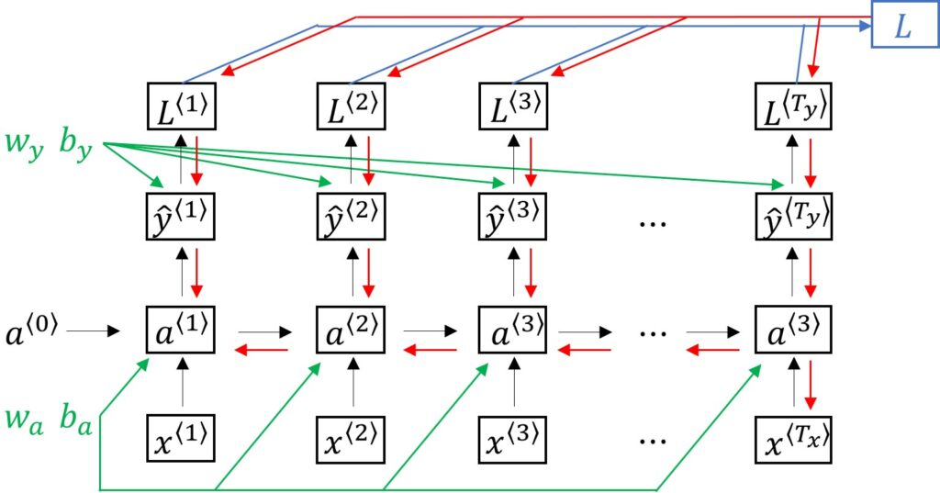
Back Propagation through time

Slide 31
RNN classification
We can categorize RNN architectures broadly into these four buckets:
Many Inputs to Many Outputs
Many Inputs to One Output
One Input to One Output
One Input toMany Outputs

Slide 32
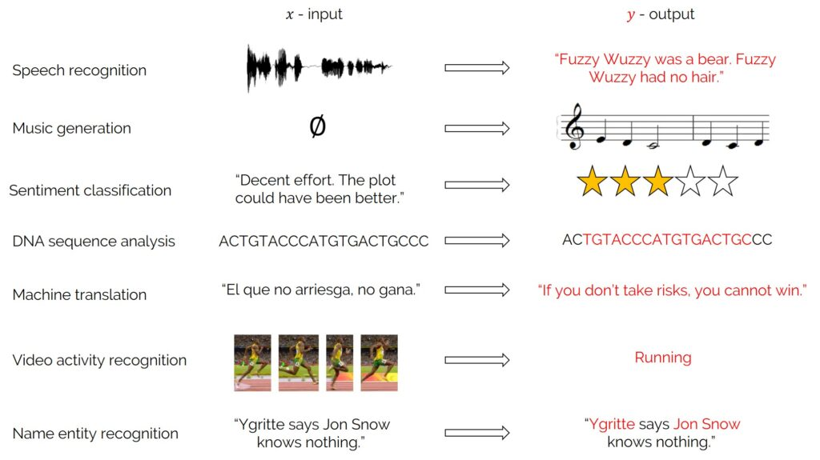

Slide 33
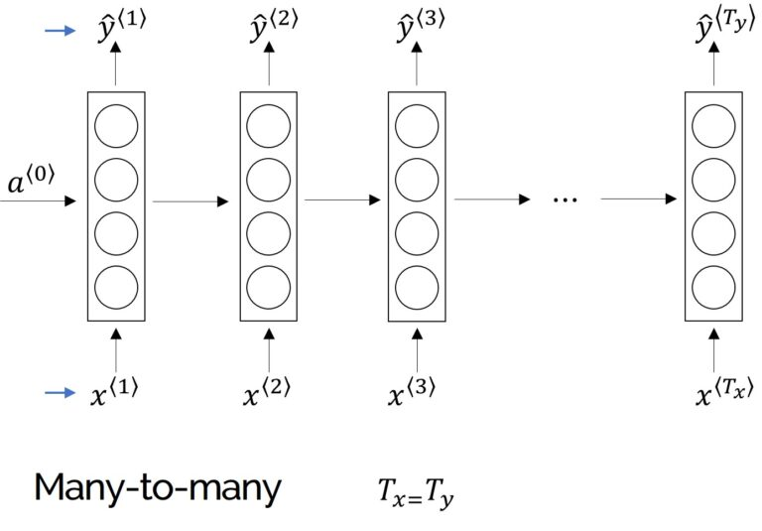
Many-to-Many Architecture

Slide 34
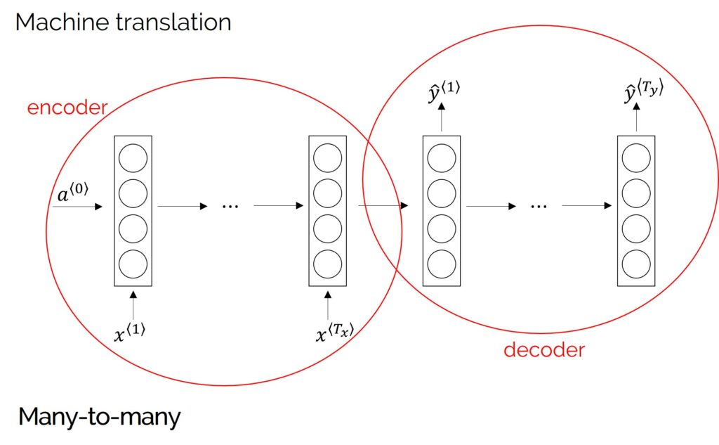
Many-to-Many Architecture

Slide 35
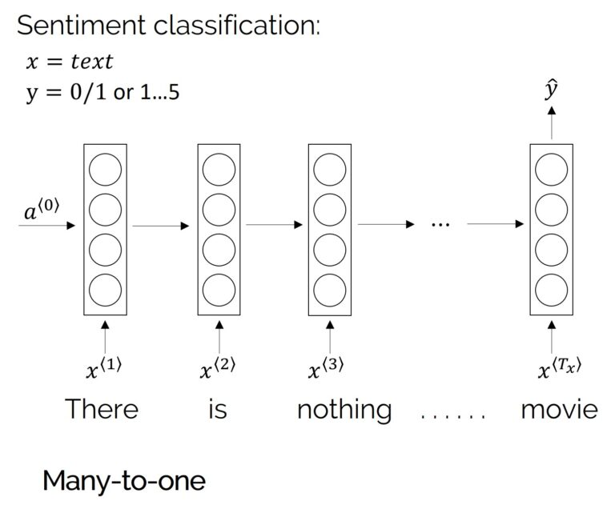
Many-to-One Architecture

Slide 36
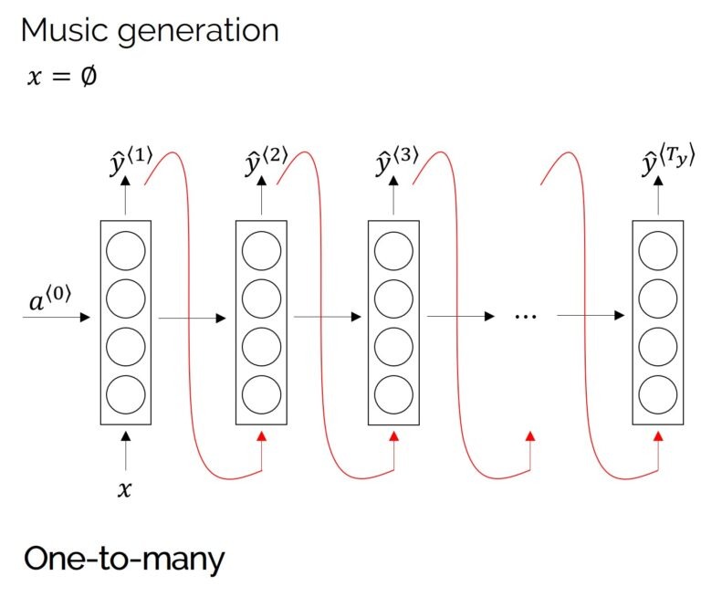
One-to-Many Architecture

Slide 37
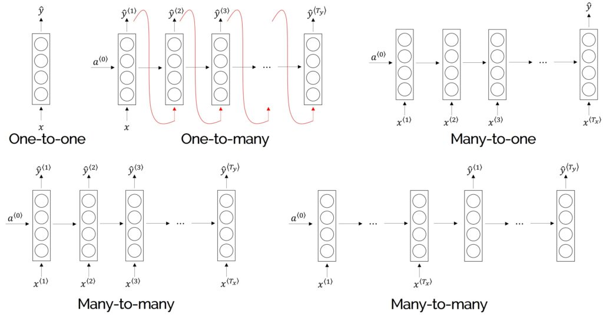

Slide 38
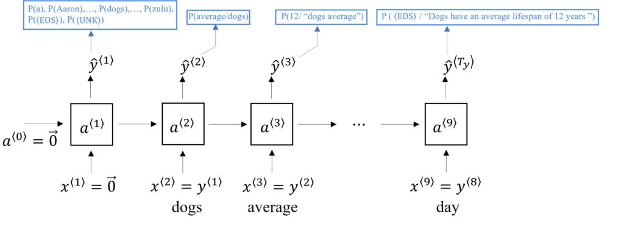
Language Modelling and Sampling Novel Sequences

Slide 39
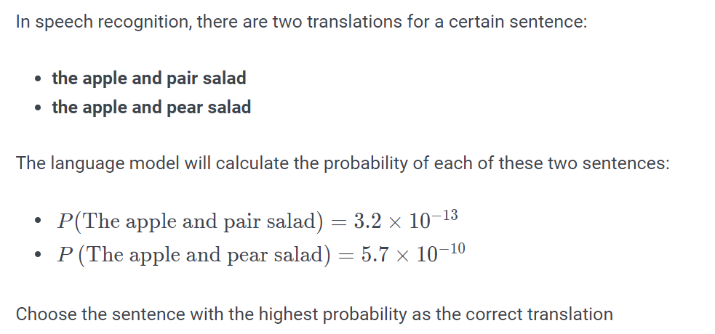
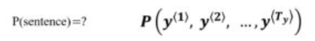
What is Language Modelling?

Slide 40
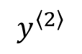
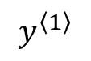
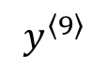
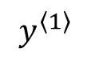
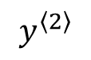
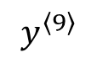
Building a Language Model Using RNN
Cats average 15 hours of sleep a day.
<EOS>
<EOS> End of sentence token
$$y^{\left\langle 1\right\rangle }$$
$$y^{\left\langle 2\right\rangle }$$
…
$$y^{\left\langle 9\right\rangle }$$
The Egyptian Mau is a bread of cat. <EOS>
$$y^{\left\langle 1\right\rangle }$$
$$y^{\left\langle 2\right\rangle }$$
<UNK>
…
$$y^{\left\langle 9\right\rangle }$$
<UNK>: Unknown token

Slide 41
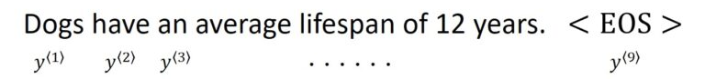
Building RNN Architecture

Slide 42
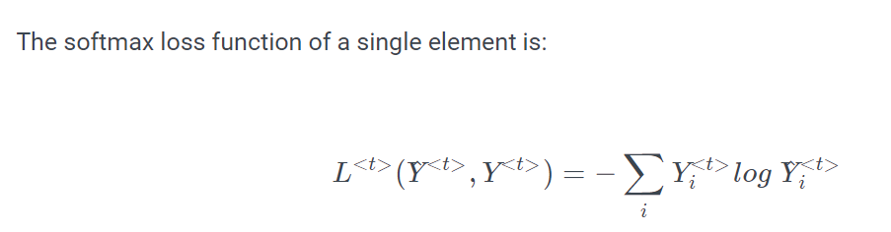
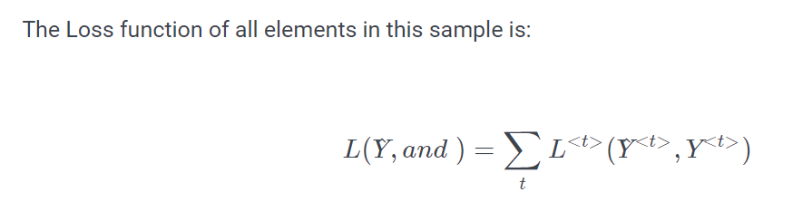
Building RNN Architecture

Slide 43

Building RNN Architecture
Given "Cats average 15" , the RNN model may predict that the complete sentence is "Cats average 15 hours of sleep a day.“
For example, a statement contains $y^{\left\langle 1\right\rangle },y^{\left\langle 2\right\rangle },y^{\left\langle 3\right\rangle }$, the probability of the entire sentence is:

Slide 44


Sampling a Sequence From a Trained RNN

Slide 45

Sampling a Sequence From a Trained RNN

Slide 46

Character-Level Language Model

Slide 47

Tackling Vanishing Gradients with GRU and LSTM

Slide 48

Long-term dependencies.

Slide 49

Vanishing Gradients

Slide 50

Vanishing Gradients

Slide 51

Illustration of short term memory in RNN

Slide 52

Notes:
LSTM and GRU includes gates, which decide which information in the sequence to keep or forget.

Slide 53


Long short term memory

Slide 54

RNN

Slide 55

RNN

Slide 56

RNN

Slide 57


LSMT

Slide 58

LSTM: cell state

Slide 59


LSTM: gate

Slide 60

LSTM: forget gate

Slide 61

LSTM: input gate

Slide 62

LSTM: update old cell state
Long term memory

Slide 63

LSTM: cell activation output
Short term memory

Slide 64

Variants on Long Short Term Memory

Slide 65

Variants on Long Short Term Memory

Slide 66

Variants on Long Short Term Memory

Slide 67
Gated Recurrent Unit (GRU)
Reset
Update

Slide 68


Slide 69

Bidirectional RNN

Slide 70



























Deep RNN
$$y^{<1>}$$
$$y^{<2>}$$
$$y^{<3>}$$
$$y^{<4>}$$
$$W_{a}^{\left[3\right]},b_{a}^{[3]}$$
$$a^{[3]<0>}$$
$$a^{[3]<1>}$$
$$a^{[3]<2>}$$
$$a^{[3]<4>}$$
$$a^{[3]<3>}$$
$$W_{a}^{\left[2\right]},b_{a}^{[2]}$$
$$a^{[2]<0>}$$
$$a^{[2]<2>}$$
$$a^{[2]<4>}$$
$$a^{[2]<1>}$$
$$a^{[2]<3>}$$
$$W_{a}^{\left[1\right]},b_{a}^{[1]}$$
$$a^{[1]<0>}$$
$$a^{[1]<1>}$$
$$a^{[1]<2>}$$
$$a^{[1]<3>}$$
$$a^{[1]<4>}$$
$$x^{<1>}$$
$$x^{<2>}$$
$$x^{<3>}$$
$$x^{<4>}$$

Slide 71























Deep RNN
$$y^{<1>}$$
$$y^{<2>}$$
$$y^{<3>}$$
$$y^{<4>}$$
$$W_{a}^{\left[3\right]},b_{a}^{[3]}$$
$$a^{[3]<0>}$$
$$a^{[3]<1>}$$
$$a^{[3]<2>}$$
$$a^{[3]<4>}$$
$$a^{[3]<3>}$$
$$W_{a}^{\left[2\right]},b_{a}^{[2]}$$
$$a^{[2]<0>}$$
$$a^{[2]<2>}$$
$$a^{[2]<4>}$$
$$a^{[2]<1>}$$
$$a^{[2]<3>}$$
$$W_{a}^{\left[1\right]},b_{a}^{[1]}$$
$$a^{[1]<0>}$$
$$a^{[1]<1>}$$
$$a^{[1]<2>}$$
$$a^{[1]<3>}$$
$$a^{[1]<4>}$$
$$x^{<1>}$$
$$x^{<2>}$$
$$x^{<3>}$$
$$x^{<4>}$$

Slide 72



Deep RNN
…
…
…
…
$$a^{[5]<1>}$$
$$a^{[4]<1>}$$

Slide 73



Word Representation
$$O_{5391}$$
$$O_{9853}$$

Slide 74


Featurized representation
 | Man (5391) | Woman (9853) | King (4914) | Queen (7157) | Apple (456) | Orange (6257)
Gender | -1 | 1 | -0.95 | 0.97 | 0.00 | 0.01
Royal | 0.01 | 0.02 | 0.93 | 0.95 | -0.01 | 0.00
Age | 0.03 | 0.02 | 0.7 | 0.69 | 0.03 | -0.02
Food | 0.04 | 0.01 | 0.02 | 0.01 | 0.95 | 0.97
...
300
$$e_{5391}$$
$$e_{9853}$$

Slide 75


Visualizing word embedding
apple
cat
dog
orange
Each word is embedded to 300 dimensional space.

Slide 76




Name entity recognition example
$$1$$
$$1$$
$$0$$
$$0$$
$$0$$
$$0$$
Sally Johnson is an orange farmer
Robert Lin is an apple farmer
Johnson Sally is a durian cultivator
Word embedding dataset: 100B words
Name entity recognition: 100k words (transfer learning)

Slide 77


Slide 78




Analogies
 | Man (5391) | Woman (9853) | King (4914) | Queen (7157) | Apple (456) | Orange (6257)
Gender | -1 | 1 | -0.95 | 0.97 | 0.00 | 0.01
Royal | 0.01 | 0.02 | 0.93 | 0.95 | -0.01 | 0.00
Age | 0.03 | 0.02 | 0.7 | 0.69 | 0.03 | -0.02
Food | 0.04 | 0.01 | 0.02 | 0.01 | 0.95 | 0.97
...
$$e_{5391}$$
$$e_{man}$$
$e_{man} − e_{woman}$ $=e_{king}−e_{queen}$
Man -> Woman $≈$ King -> ?
$e_{man} − e_{woman}$ $=e_{king}−e_{?}$

Slide 79

$$\max_{w}{sim(ew, e_{king}−e_{man}+ewoman )}$$

Slide 80

Cosine similarity

Slide 81



Embedding matrix
6257
A | Aaron | …. | Orange | … | Zulu | <UNK>
. | . | . | . | . | . | .
. | . | . | . | . | . | .
. | . | . | . | . | . | .
. | . | . | . | . | . | .
$$O_{6257}=\left[\begin{aligned}0 \\ 0 \\ ⋮ \\ 1 \\ ⋮ \\ 0\end{aligned}\right]$$
300
Number of word
.
.
.
.
$$E⋅O_{6257}= =e_{6257}$$
$E⋅O_{j}=e_{j}$ (embedding for word j)

Slide 82
Word embedding learning model
Natural language model
Word2Vec
GloVe

Slide 83



















Natural language model (embedding layer)
I want a glass of orange _juice_.
$$9665$$
$$1$$
$$3852$$
$$6163$$
$$6257$$
I
$$o_{4343}$$
$$E$$
$$e_{4343}$$
A
want
$$o_{9665}$$
$$E$$
$$e_{9665}$$
a
Aaon
$$o_{1}$$
$$E$$
$$e_{1}$$
Juice
softmax
glass
$$o_{3852}$$
$$E$$
$$e_{3852}$$
Zulu
of
$$o_{6163}$$
$$E$$
$$e_{6163}$$
orange
$$o_{6257}$$
$$E$$
$$e_{6257}$$
10000
Embedding layer
1800

Slide 84
Generalizing the model
Context
Word
Other kinds of (simpler) context/targets:
context=4 words to the left & right, target=the word in the middle
context=previous word, target=next word
context=nearby 1 word

Slide 85

Word2Vec

Slide 86
CBOW

Slide 87





CBOW

Slide 88

CBOW

Slide 89






CBOW

Slide 90


CBOW

Slide 91









CBOW
$$W_{word}h[i]=W_{word}W_{context}x$$
i column in $W_{word}$
j column in $W_{context}$

Slide 92




CBOW

Slide 93

CBOW

Slide 94



CBOW
$$v_{w}=v_{w}+ηu_{c}$$

Slide 95
CBOW
Word
Dog
Cat
Context
Eat, Sleep

Slide 96

CBOW

Slide 97

CBOW

Slide 98

CBOW

Slide 99
Skip-gram

Slide 100

CBOW problem

Slide 101



Skip-gram

Slide 102



Negative sampling

Slide 103




Negative sampling

Slide 104


Negative sampling

Slide 105

Negative sampling

Slide 106


Slide 107
GloVe (Global Vector)
Sentence: I want a glass of orange juice to go along with my cereal.
Xij : # j appears in context i
c
t

Slide 108

Glove
m$inimize \sum_{i=1}^{10,000}{\sum_{j=1}^{10,000}{f\left(X_{ij}\right){\left(θ_{i}^{T}e_{j}+b_{i}+b_{j}^{′}−\log{X_{ij}}\right)}^{2}}}$
extra weighting term
f(X_{ij}):
Nếu X_{ij} = 0 thì f(X_{ij}) = 0 ➔ no need to concern (c,t) hiện tại.
f(Xij) add weight for different words

Slide 109
SENTIMENT CLASSIFICATION
X
y
The dessert is excellent.
Service was quite slow.
Good for a quick meal, but nothing special.

Slide 110















SENTIMENT CLASSIFICATION
The dessert is excellent
$$8928$$
$$2468$$
$$4694$$
$$3180$$
Embedding vector (word embedding)
The
$$o_{8928}$$
$$E$$
$$e_{8928}$$
desert
$$o_{2468}$$
$$E$$
$$e_{2468}$$
AVG
$$\hat{y}$$
is
$$o_{4694}$$
$$E$$
$$e_{4694}$$
softmax
excellent
$$o_{3180}$$
$$E$$
$$e_{3180}$$

Slide 111

















SENTIMENT CLASSIFICATION
$$\hat{y}$$
softmax
$$a^{<0>}$$
$$a^{<1>}$$
$$a^{<2>}$$
$$a^{<3>}$$
$$a^{<4>}$$
$$⋯$$
$$a^{<10>}$$
$$e_{1852}$$
$$e_{4966}$$
$$e_{4427}$$
$$e_{3882}$$
$$e_{330}$$
Embedding
$$E$$
$$E$$
$$E$$
$$E$$
$$E$$
Completely lacking in good …. ambience

Slide 112
Tbc.

